Slide 1
BRDF reconstruction using MERL database
Yuan Meng
15-663 Computational Photography Final Project
Notes:
Hi Everyone. Today I’m going to introduce my final project, which is about reconstruct BRDF using known BRDF databases, such as MERL.

Slide 2
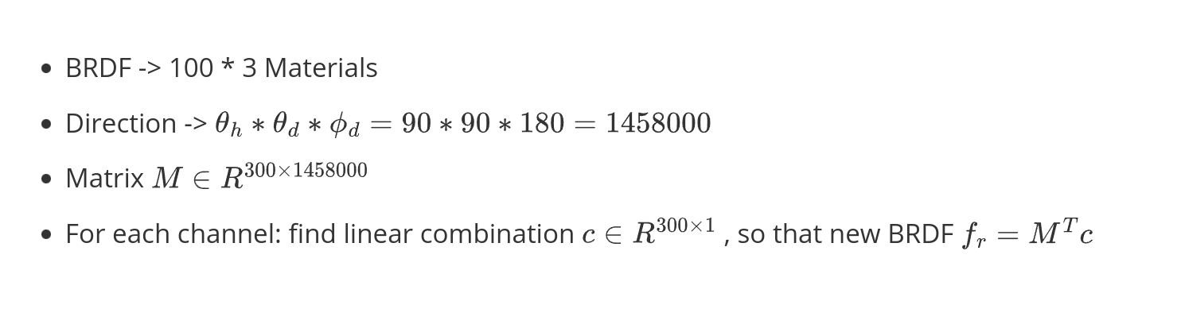
Linear Combination of MERL isotropic BRDF
Notes:
The idea of this project is that. Merl database has 100 materials, each with RGB channel so that sum up to 300 materials. And because all MERL materials are isotropic, the direction will be reduced to 3D. MERL has in total 1.45 million directions in half-diff space. So now we have a matrix of 300 * 1458000. For any new material, we want to find the linear combination c, which give weights to each MERL material. The BRDF of this new material will simply be a linear combination of all 300 MERL material.

Slide 3
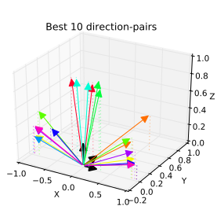
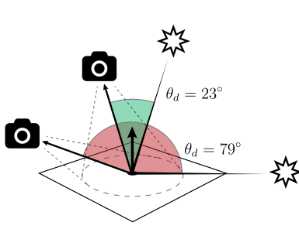
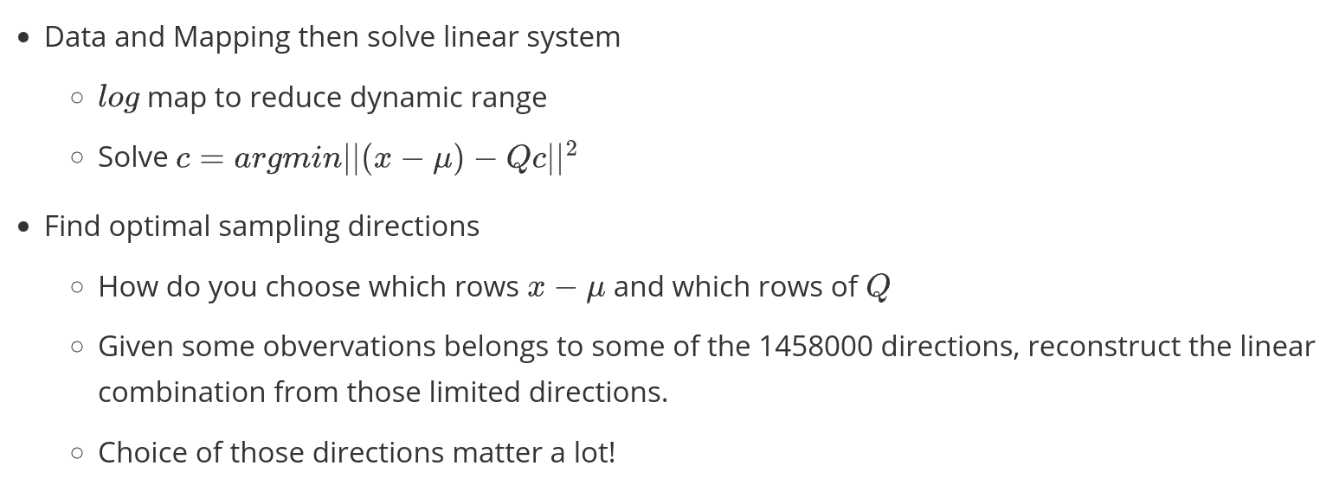
Two Tasks
Then find principal components using SVD
Notes:
TO achieve this. We basically have two tasks. One is process tha data and find a good space to do the reconstruction process, then find the principal components using SVD, then optimize c, which is an least square optimization problem, The second task is, given limited amout of resource,finding the best sampling directions among the 1458000 directions. If we have unlimited, fast way to acquire the BRDF, we would just do this rather than finding some combination. So in reality, we need to choose the directions pair. The project explore two settings. 1. directly finding directions (theta_h,theta_d,phi_d) 2. finding camera/light position pair. then take image of the planar surface, use all samples on that surface.

Slide 4
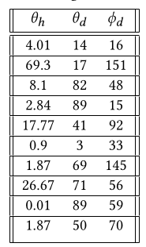
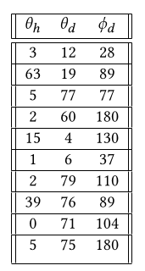
Results of optimizing directions
Using conditional number as error metric(ration between max singular value and min singular value)
Do gradient descent
My result
Reference result
Mine actually has lower conditional number
Notes:
For points directions. Conditional number of the selected principal components is used as the error metrics. My result is on the left, it has a lower condition number than the ref one.
The camera/light pair one has a new error metric, which is impossible to run locally(it fills 64GB RAM and would take at least 10 hourse to run a few iterations), so the below experiment I just use the reference direction.

Slide 5
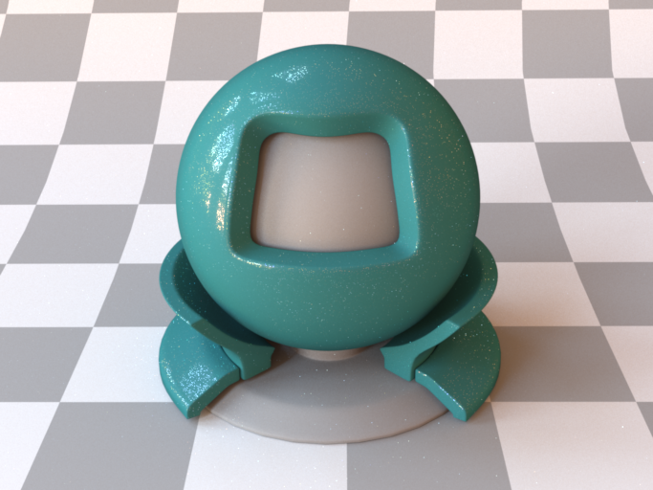
Reconstruction Result
ground truth

Slide 6

Reconstruction Result
self-generated 10 points
Notes:
It’s obviously Darker

Slide 7

Reconstruction Result
two near-field photo
Notes:
It doesn’t has black ring

Slide 8
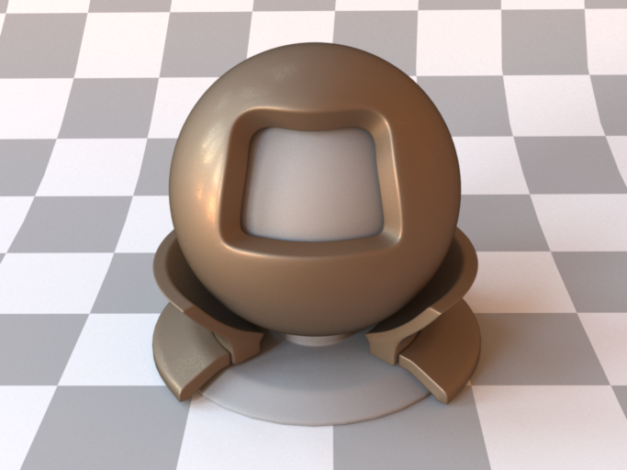
Reconstruction Result
ground truth

Slide 9
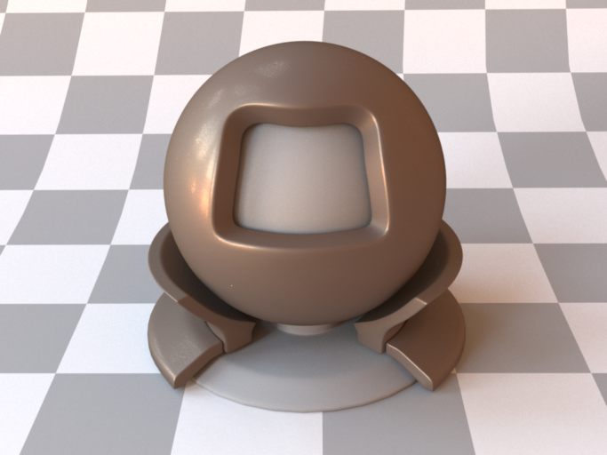
Reconstruction Result
self-generated 10 points
Notes:
It;s more brownish

Slide 10

Reconstruction Result
ref 10 points
Notes:
Better than self, still brown, looking strange at outer rim

Slide 11
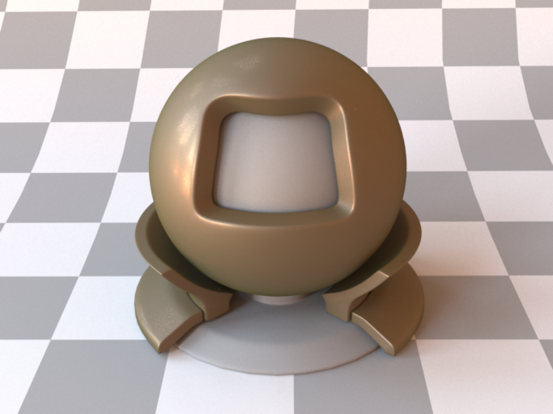
Reconstruction Result
two near-field photo
Notes:
Too gold

Slide 12

Reconstruction Result
8k samples from McMC
Notes:
if Given more samples, it will fit perfectly to the original data

Slide 13
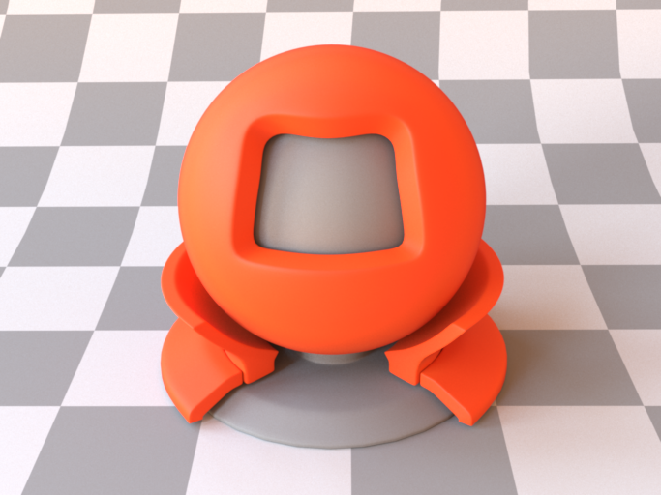
Reconstruction Result
ground truth

Slide 14

Reconstruction Result
self-generated 10 points
Notes:
Darker

Slide 15
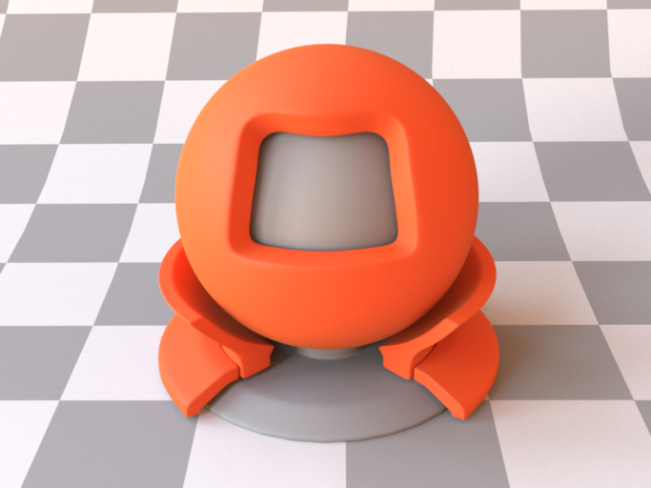
Reconstruction Result
ref 10 points
Notes:
Still darker but better

Slide 16

two near-field photo
Notes:
Almost the same, but look at the grazing angles

Slide 17
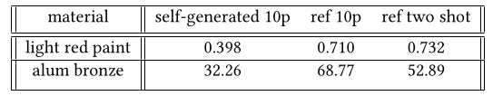
Problems and Improvements
Grazing angles
Point samples, darker color
low RMSE, worse result?

Slide 18
Thank You!

